Slide 1
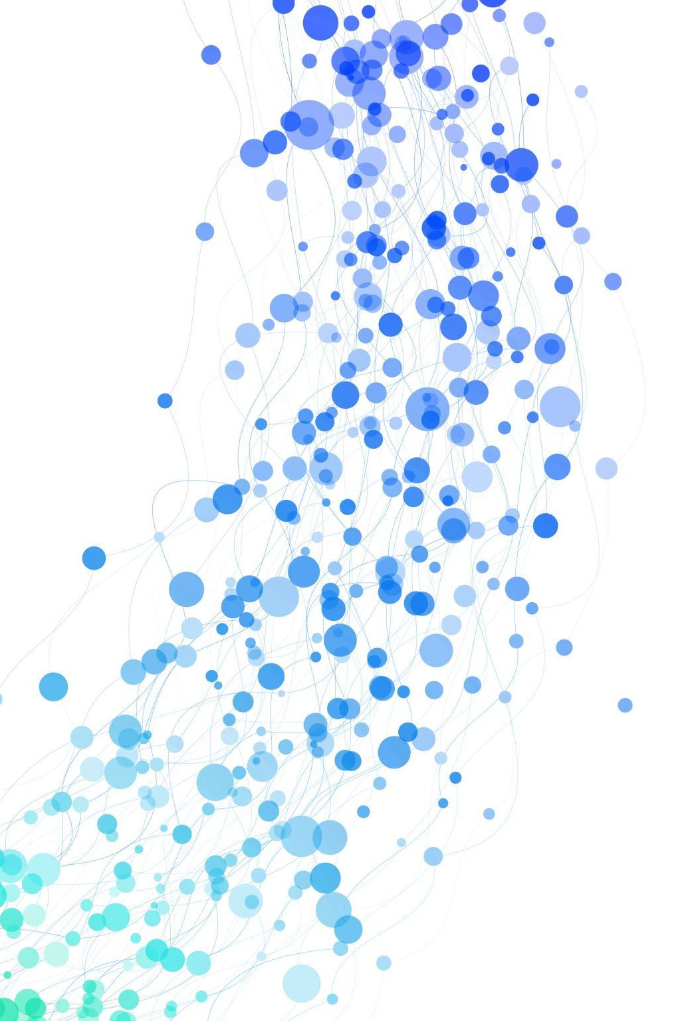
DAMALL: A Framework to detect automated and manual attacks on Cyber Systems
Subhasis Mukhopadhyay, Tanmay Thapliyal, Chunduri Naga Venkata Hrushikesh, Kriti MajumdAr, Ashee Jain, Atanu Kar

Slide 2
The Problem
Attacking tools available very easily
Lack of actionable threat intelligence
Attacker's modus-operandi detection
Quick Response from SoC Analysts
Traditional ways not very efficient in detecting manual/automated attacks

Slide 3
The DAMALL Solution
Framework for detecting manual and automated attacks
Develop
Develop HTTP Honeypot with specific vulnerabilities
Design
Design Network and Virtual Machines for deployment of the honeypot
List out
List out attacks to be performed
Research about
Research about manual ways to do the attack and automated tools available for the same
Perform
Perform the attacks as a team (just like attackers)
Note
Note IPs involved in attack, deployed honeypots IPs and capture network traffic

Slide 4
DAMALL Architecture

Slide 5
The attacks in DAMALL (HTTP)
SQL Injection [SQLMap]
Cross-Site Scripting (XSS) [XSSStrike]
Command Injection [Commix]
Directory Traversal [DotDotPwn, Dirb]

Slide 6
Details of Attacker's IP in DAMALL
Automated Attacks Honeypot VM – 192.168.1.105
Manual Attacks Honeypot VM – 192.168.1.104
Automated Attackers – 192.168.1.125, 192.168.1.115, 192.168.1.110
Manual Attackers – 192.168.1.101, 192.168.1.130, 192.168.1.135

Slide 7
Time Frame for Attacks in DAMALL
Automated Attacks
SQLi | 16:04-16:34
XSS | 17:25-17:55
Command Injection | 15:22-15:58
Directory Traversal | 16:35-17:15
Manual Attacks
SQLi | 16:13-16:43
XSS | 17:22-17:52
Command Injection | 15:22-15:52
Directory Traversal | 16:35-17:05

Slide 8
Features Extracted from PCAPs
Features used to train model
frame.time
frame.time_delta
frame.time_delta_displayed – There is no difference in values with respect to frame.time_delta, hence it is not considered
frame.time_invalid – There are no frame retransmissions, hence it is not considered
frame.time_relative
We took frame.time, frame.time_delta, and frame.time_relative as relevant features and fed them to ts-fresh. frame.time is taken as the reference for feature extraction.
frame.time_delta__sum_values , frame.time_delta__median , frame.time_delta__mean , frame.time_delta__standard_deviation , frame.time_delta__variance, frame.time_delta__root_mean_square , frame.time_delta__maximum , frame.time_relative__sum_values , frame.time_relative__mean , frame.time_relative__standard_deviation , frame.time_relative__variance , frame.time_relative__maximum , frame.time_relative__minimum

Slide 9
Dataset Breakdown (After TS-Fresh)
Data for Training and Testing
Data for Validation​
S.No | Attack Type | Count
1 | Automated SQL Injection | 10894
2 | Automated Command Injection | 7114
3 | Automated Directory Traversal | 5004
4 | Automated XSS | 5797
5 | Manual SQL Injection | 1017
6 | Manual Command Injection | 840
7 | Manual Directory Traversal | 880
8 | Manual XSS | 3875
9 | Total Samples | 35421
S.No​​ | Attack Type​​ | Count​​
1​​ | Automated SQL Injection​​ | 5767​​
2​​ | Automated Command Injection​​ | 1580​​
3​​ | Automated Directory Traversal​​ | 2859​​
4​​ | Automated XSS​​ | 5310​​
5​​ | Manual SQL Injection​​ | 242​​
6​​ | Manual Command Injection​​ | 142​​
7​​ | Manual Directory Traversal​​ | 243​​
8​​ | Manual XSS​​ | 144​​
9​​ | Total Samples​​ | 16287​​

Slide 10
Testing Results
Classifier | Accuracy | Kappa | Sensitivity | Specificity
RF | 95.05 | 83.46 | 84.75 | 97.42
GBM | 94.16 | 80.22 | 80.76 | 97.24
KNN | 87.07 | 56.20 | 61.77 | 92.88
SVM​ | 91.85 | 70.03 | 64.67 | 98.08
GBM Confusion Matrix
 | Reference
Prediction | 0 | 1
0 | 1335 | 199
1 | 318 | 7003
RF Confusion Matrix
 | Reference
Prediction | 0 | 1
0 | 1401 | 186
1 | 252 | 7016
SVM Confusion Matrix
 | Reference
Prediction | 0 | 1
0 | 1069 | 138
1 | 584 | 7064
KNN Confusion Matrix
 | Reference
Prediction | 0 | 1
0 | 1021 | 513
1 | 632 | 6689
0 – Manual Attacks
1- Automated Attacks

Slide 11
Validation Results
Classifier | Accuracy | Kappa | Sensitivity | Specificity
RF | 93.33 | 52.18 | 87.03 | 93.64
GBM | 96.06 | 64.77 | 83.65 | 96.67
KNN | 93.13 | 44.06 | 65.49 | 94.50
SVM​ | 92.31 | 44.65 | 75.61 | 93.14
GBM Confusion Matrix
 | Reference
Prediction | 0 | 1
0 | 645 | 516
1 | 126 | 15000
RF Confusion Matrix
 | Reference
Prediction | 0 | 1
0 | 671 | 986
1 | 100 | 14530
SVM Confusion Matrix
 | Reference
Prediction | 0 | 1
0 | 583 | 1064
1 | 188 | 14452
KNN Confusion Matrix
 | Reference
Prediction | 0 | 1
0 | 585 | 853
1 | 266 | 14663
0 – Manual Attacks
1- Automated Attacks

Slide 12
Future Work
Include more types of protocols and attacks
Including more relevant time-based features
Multi-class classification
Near Real-Time Detection and Reporting

